Slide 1

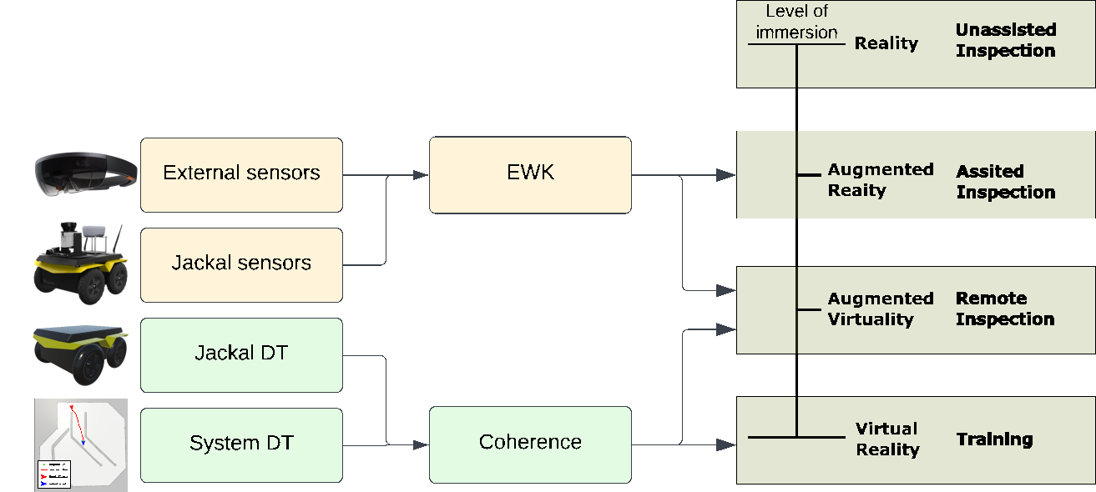
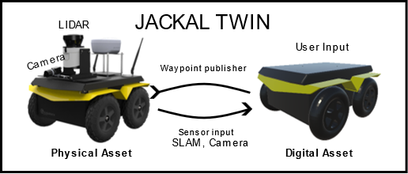
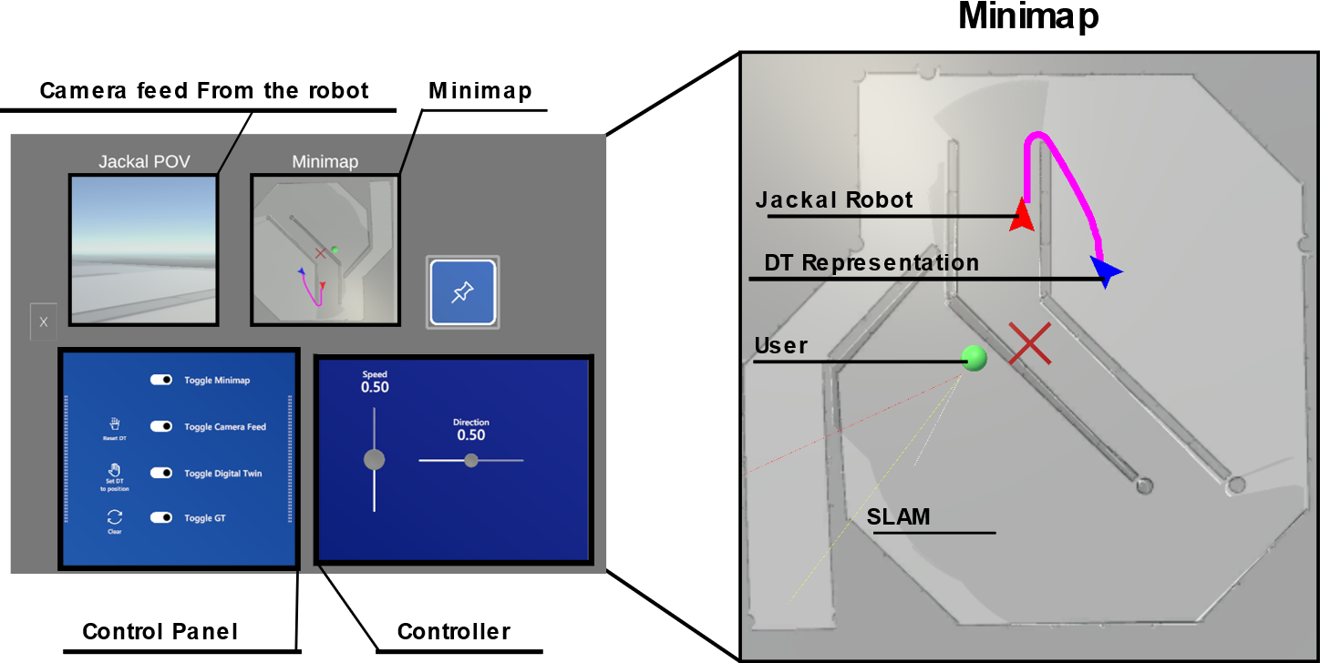
Jackal HoloLens
Objectives
Create a HoloLens based application for intuitive teleoperation of the jackal robot.
Train and assist Inspection and maintenance task using knowledge of the digital representation.
Column 2
Introduction & Background
Inspection and maintenance of critical infrastructures often necessitate human presence, which can be costly and risky. Autonomous robots, in tandem with a digital twin representation of the facility, can serve as a safer and more economical alternative. These robots, with high-level decision-making abilities, not only lessen the need for on-site human operators but also allow them to remotely control multiple robots simultaneously. Such systems also enable fault simulation for better operator training.
Digital Twin(EWK): A virtual replica of a physical asset or system, used to optimize and understand its physical counterpart.
Levels of Autonomy: Framework that defines the degree of human involvement in controlling a robotic system
Reality-Virtuality Continuum: The different levels of immersion in virtual environments, ranging from real-world experiences to fully virtual ones.
Cognitive Load: The mental effort required to perform a task, an essential consideration in designing human-robot interfaces to minimize unnecessary burden on operators.
Methodology and Implementation
paragraph – 24pt arial
Conclusion
& Future work
paragraph – 24pt arial
Results
paragraph – 24pt arial
University of Glasgow, charity number SC004401

